Slide 1
Lesson: Looping

Slide 2
Looping:
sometimes we need to execute the block of code repeatedly while some condition evaluates to true.
we have three types of loops that execute similarly
for loop
while loop
do-while loop

Slide 3
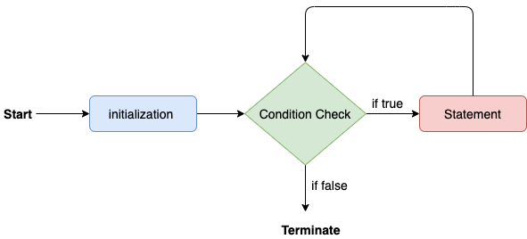
For loop:
We use the for loop only when we exactly know the number of times, we want to execute the block of code.
Syntax:
for(initialization, condition, increment/decrement) {
//block of statements
}

Slide 4
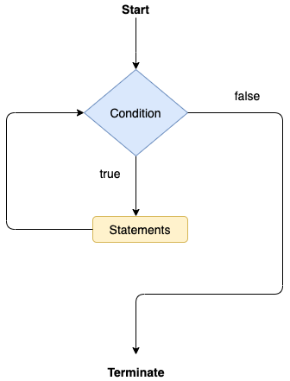
While loop:
Unlike for loop, the initialization and increment/decrement doesn't take place inside the loop statement in while loop.
Syntax:
while(condition){
//looping statements
}

Slide 5
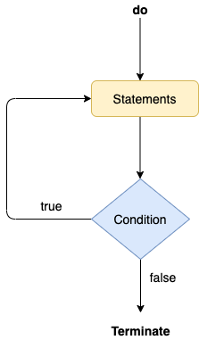
Do-While loop:
The do-while loop checks the condition at the end of the loop after executing the loop statements.
Syntax:
do
{
//statements
} while (condition);

Slide 6
Jump Statements:
Break:
The break statement is used to break the current flow of the program and transfer the control to the next statement outside a loop or switch statement.
The break statement cannot be used independently in the Java program, i.e., it can only be written inside the loop or switch statement.
Continue:
Unlike break statement, the continue statement doesn't break the loop, whereas, it skips the specific part of the loop and jumps to the next iteration of the loop immediately.

Slide 7
Thank You!! We will Continue with Array

